Slide 1

Team Number : 57
Batch number: 18
1.Name: S. SRIKAR Hall ticket no:2403a52240
2.Name: K. AKHIL Hall ticket no:2403a52241
3.Name: J. HEMANTH Hall ticket no:2403a52242
4.Name: AYESHA FARHEEN Hall ticket no:2403a52243
5.Name: V. ANOGNYA REDDY Hall ticket no:2403a52244

Slide 2
Summary of the Problem statement
Create a “Create account” function and Enter Account number, Name, Initial balance from the console if any error occurs then raise the error create deposit money function and add the money to initial balance create withdraw money function and withdraw the money from initial balance if any error occurs then raise the error check the initial balance create a menu exit from the menu.

Slide 3
Hardware and Software Requirementsl
laptop
Minimum 1 GB
Thonny
Python 3
Windows operating system

Slide 4
Algorithm
Start
Display Menu
Options: Create an Account, Deposit Money, Withdraw Money, Check Balance, Exit
User Chooses an Option
If Create an Account:
Input: Account Number, Account Holder Name, Initial Balance
Check if Account Number is Unique
If not, raise InvalidAccount
If yes, create account and display success message
If Deposit Money:
Input: Account Number, Deposit Amount
Check if Account Exists
If not, raise InvalidAccount
  If yes, check if Deposit Amount is Positive
If not, raise InvalidAmount
If yes, update balance and display success message
If Withdraw Money:
Input: Account Number, Withdrawal Amount
Check if Account Exists
If not, raise InvalidAccount
If yes, check if Withdrawal Amount is Positive
If not, raise InvalidAmount
If yes, check if Sufficient Balance is Available
If not, raise InsufficientBalanceException
If yes, update balance and display success message
If Check Balance:
Input: Account Number
Check if Account Exists

Slide 5
Algorithm
If not, raise InvalidAmount
If yes, check if Sufficient Balance is Available
If not, raise InsufficientBalanceException
If yes, update balance and display success message
If Check Balance:
Input: Account Number
Check if Account Exists
If not, raise InvalidAccount
If yes, display balance
If Exit:
End Program

Slide 6
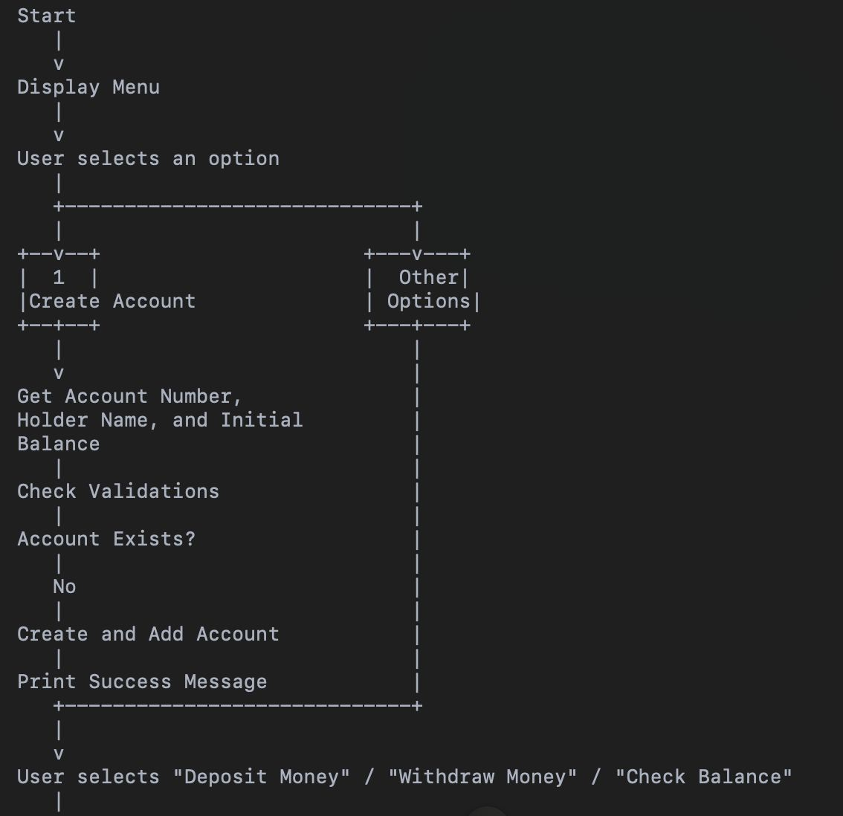
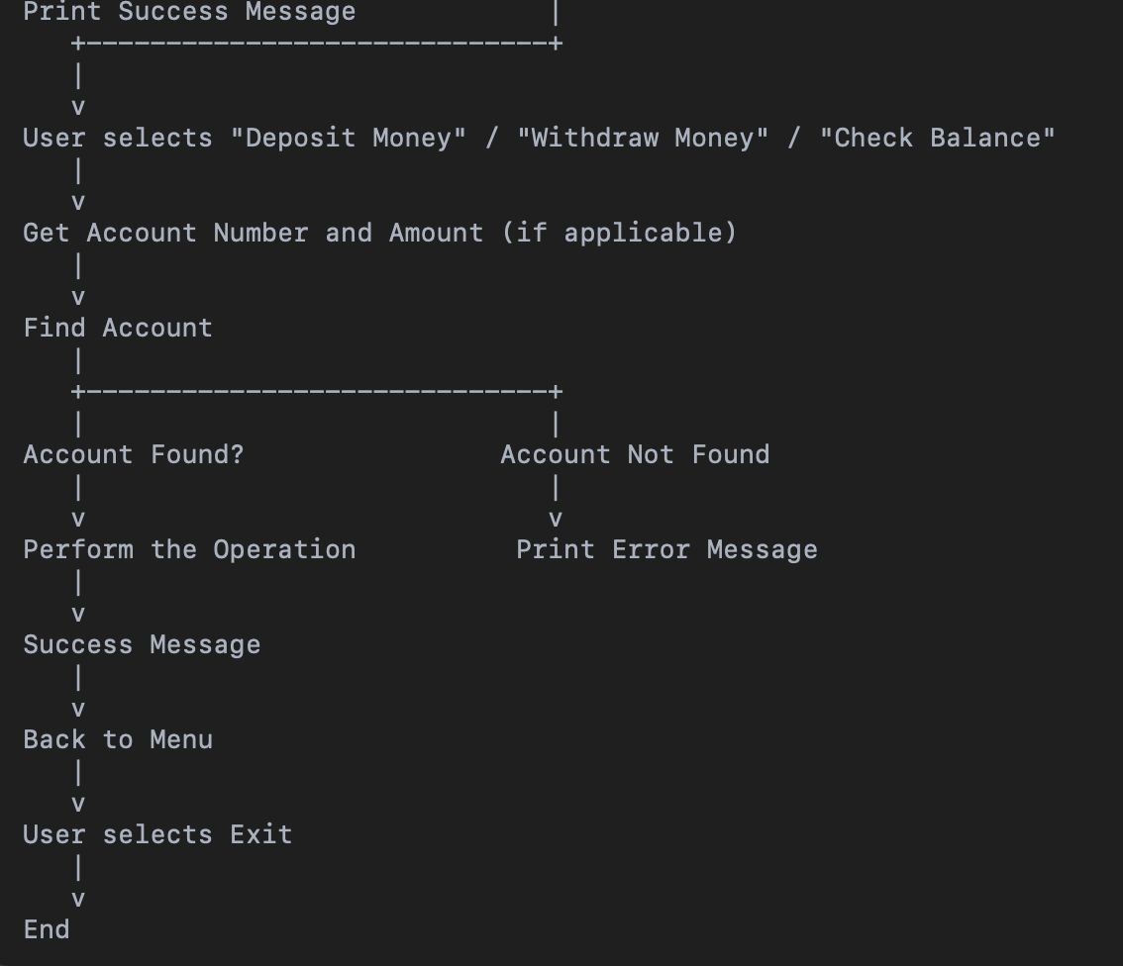
Flowchart

Slide 7
Concepts Used in this Program
→Dictionary
→Exception Handling (Try-Except Block)
→While Loop
→Conditional Statements

Slide 8
Need of the Concept
→To store the account details
→To handle errors try-except block is used
→While loop is used to create a menu driven program
→Conditional Statements are used for decition making

Slide 9
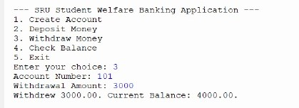
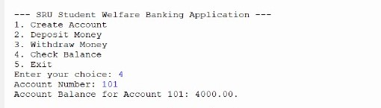
Screen Shots of Results – for each test case include one screenshot
Test case-1
TesTest case-2

Slide 10
SCREEN SHOTS OF RESULTS – FOR EACH TEST CASE INCLUDE ONE SCREENSHOT

Slide 11
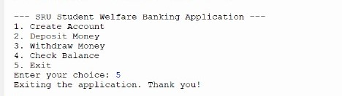
Screen Shots of Results – for each test case include one screenshot

